Slide 1
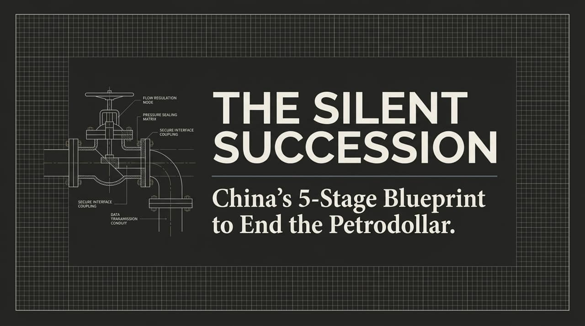
Notes:
[Introduction & Hook]: When we think about financial shifts or global currency collapses, we tend to picture dramatic events: stock market crashes, emergency central bank announcements, or headline-grabbing trade wars. But economic history reveals a very different reality.
[Core Theme — The Plumbing]: Reserve currencies almost never die with a headline or a press conference. They die quietly, years before anyone notices, deep inside payment systems that nobody outside of central banks has ever heard of. They shift inside vaults where gold quietly piles up, and in unpublicized commodity shipments that used to be settled in U.S. Dollars and suddenly aren't.
[Thesis Statement]: Over the last decade—and accelerating rapidly over the last three years—China has been laying down the precise plumbing needed to displace the dollar's 50-year monopoly on global commodity trade. Today, we are analyzing the 5-stage blueprint driving this silent succession and why the historical data points to a critical structural window between 2026 and 2027.
https://www.youtube.com/watch?v=7I6aluPph4M

Slide 2
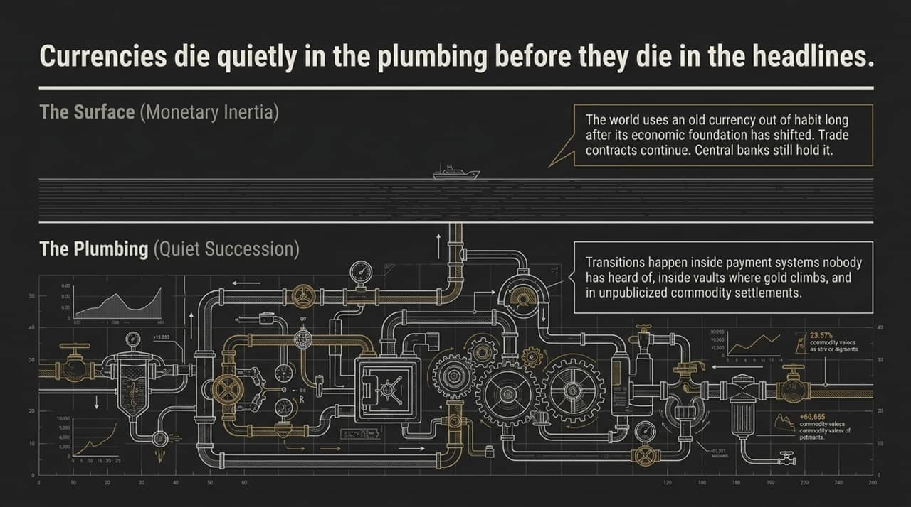
Notes:
[Concept — Surface vs. Plumbing]: To understand where we are going, we first have to recognize how currency transitions actually occur. On the surface, everything appears completely normal. Trade contracts continue to be signed in the dominant currency, central banks hold it in their reserves, and financial institutions use it out of habit.
[Defining Monetary Inertia]: In economics, this surface-level stability is called Monetary Inertia. It is the single most misunderstood force in macroeconomics. The world continues to use an incumbent currency simply because it's convenient and familiar, long after the underlying economic gravity has shifted elsewhere.
[The Underlying Reality]: Meanwhile, beneath that calm surface, the quiet succession happens in the 'plumbing'—in alternative cross-border payment networks, hidden gold accumulation, and off-market commodity clearing. By the time the surface reflects the change, the transition in the plumbing has already been completed.

Slide 3
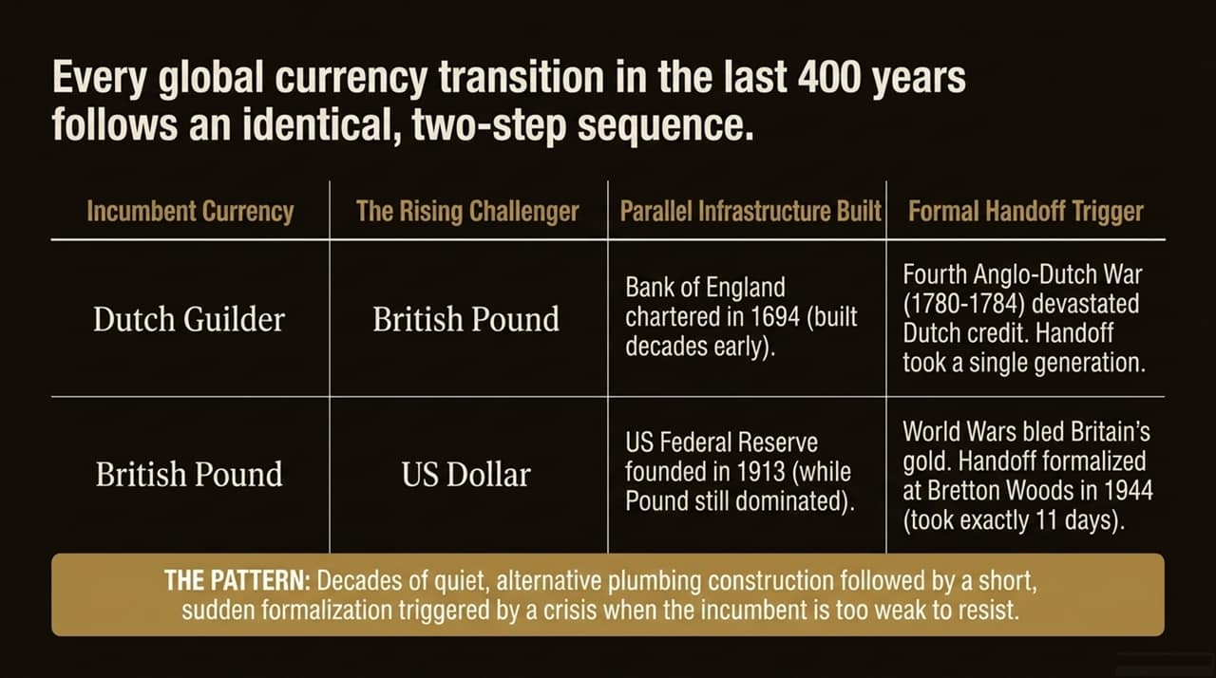
Notes:
[Historical Context]: This two-step sequence—decades of quiet alternative construction followed by a sudden formal shift—is not a theoretical model. It has played out identically twice in the last 400 years.
[Case Study 1 — Guilder to Pound]: In the 1600s, the Dutch Guilder was the undisputed global reserve currency. Yet in 1694, nearly 400 miles away, London chartered the Bank of England—a quiet backup system built decades before anyone questioned Amsterdam's dominance. When the Fourth Anglo-Dutch War hit in 1780, Dutch credit collapsed. The world didn't switch to London overnight because of the war alone; they switched because the parallel system was already built and waiting.
[Case Study 2 — Pound to Dollar]: Look at the British Pound. The US Federal Reserve was established in 1913, while the Pound was still supreme. It was dismissed as minor American plumbing. But after two world wars drained Britain's credit, 44 nations met at Bretton Woods in 1944. The infrastructure took 30 years to build; the formal handoff took just 11 days of negotiation.
[Key Takeaway]: Decades of quiet infrastructure building, followed by a short, sudden formalization when the incumbent is too weak to resist.

Slide 4
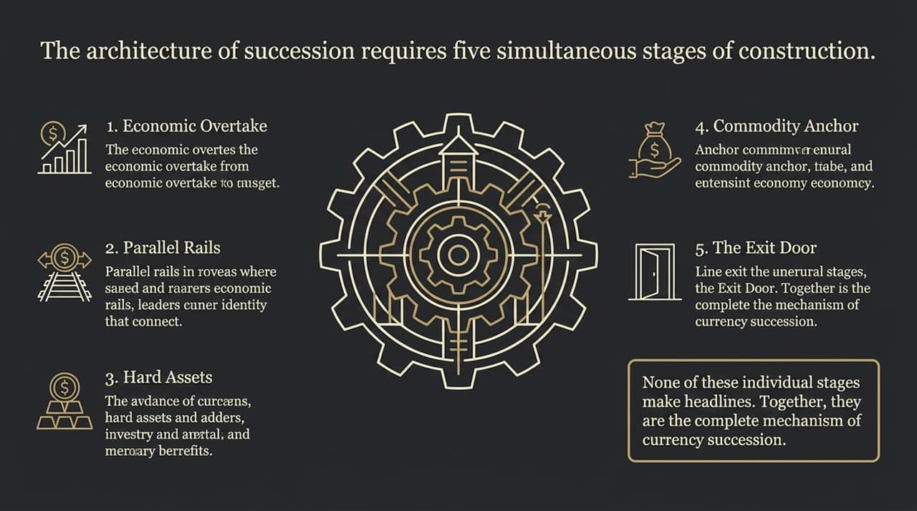
Notes:
[Overview of the Framework]: When we dissect every reserve currency displacement in modern history, we see that the challenger must execute five simultaneous operational stages.
[Stage Breakdown]:
Economic Overtake: The challenger out-trades and out-produces the incumbent economy.
Parallel Payment Rails: Building financial routing systems independent of the incumbent's oversight.
Hard Asset Accumulation: Systematically replacing paper holdings with physical reserves like gold.
Commodity Anchor: Breaking the incumbent's monopoly on pricing essential commodities, especially energy.
The Exit Door: Providing an autonomous cross-border settlement mechanism for third-party nations.
[Transition Point]: None of these five stages generate dramatic news headlines on their own. But together, they form the complete mechanical engine of currency succession.

Slide 5
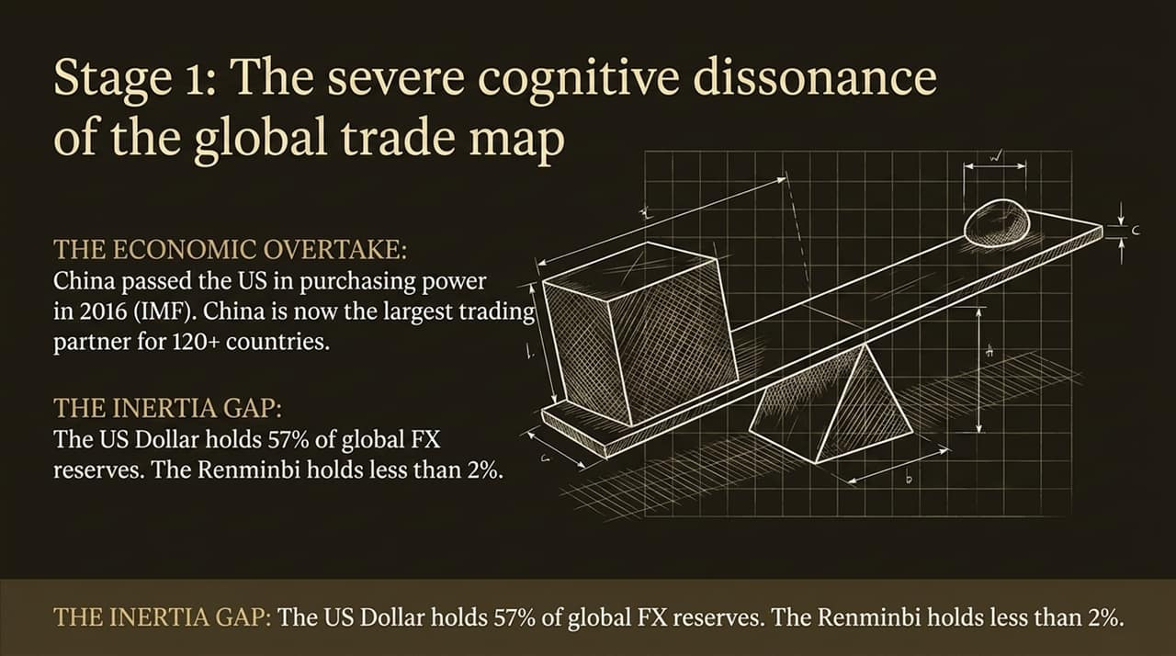
Notes:
[The Economic Overtake]: Stage 1 is already complete. According to IMF purchasing power parity data, China officially passed the United States around 2016. China is currently the largest bilateral trading partner for over 120 countries globally—significantly more than the US.
[The Cognitive Dissonance]: Yet look at the global central bank reserve data: the US Dollar still accounts for roughly 57% of official global FX reserves, while the Chinese Yuan accounts for less than 2%.
[Analyzing the Gap]: This massive gap between real-economy trade dominance and currency reserve share is the exact definition of Monetary Inertia. It is identical to the gap that existed between the US economy and the British Pound in 1900. The physical goods are flowing, but the paper money lags behind.

Slide 6
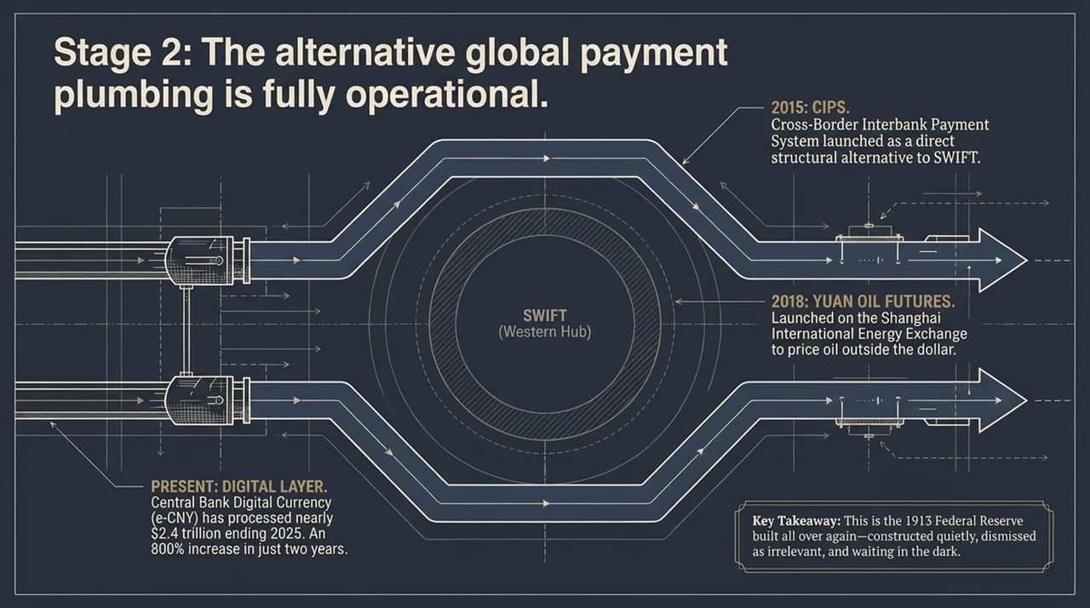
Notes:
[Building Alternative Channels]: In Stage 2, the challenger builds financial networks that bypass Western oversight.
[Key Milestones]:
2015 (CIPS): China established the Cross-Border Interbank Payment System, offering a direct, sovereign clearing system alternative to SWIFT.
2018 (Yuan Oil Futures): Shanghai launched petroyuan futures on the INE exchange, establishing a mechanism for energy contract clearing outside the dollar.
Digital Layer (e-CNY): By late 2025, China's central bank digital currency processed over $2.4 trillion in transaction volume—a massive 800% increase over a two-year span.
[Historical Equivalent]: This digital layer is the 1913 Federal Reserve created for the 21st century: constructed quietly, initially dismissed as localized, but fully operational when needed.

Slide 7
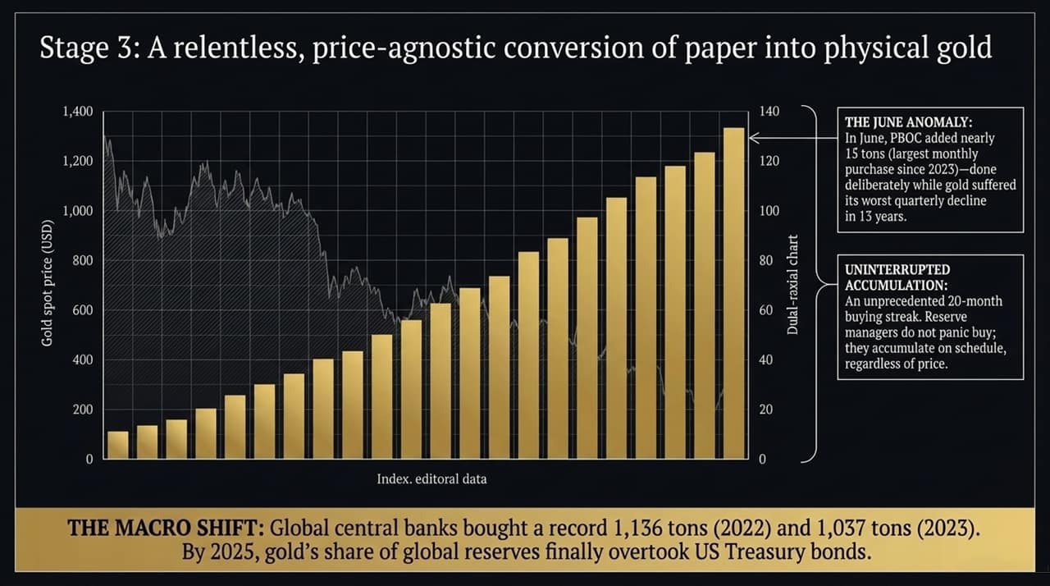
Notes:
[Gold Accumulation Dynamics]: Stage 3 involves converting fiat reserves into un-sanctionable physical assets. The PBOC has recorded an unprecedented buying streak, acquiring physical gold consistently.
[The June Anomaly]: Notice the June purchase data: the PBOC added nearly 15 tons of physical gold in a single month—its largest monthly purchase since 2023. Remarkably, they bought heavily precisely while paper gold prices were suffering their worst quarterly drop in 13 years. Sovereign reserve managers don't trade momentum; they accumulate on a strategic schedule, price-insensitively.
[Macro Reserve Shift]: On a global scale, central bank gold purchases hit all-time highs of 1,136 tons in 2022 and over 1,030 tons in 2023. By 2025, gold's percentage share of global central bank reserves officially surpassed US Treasury bonds.

Slide 8
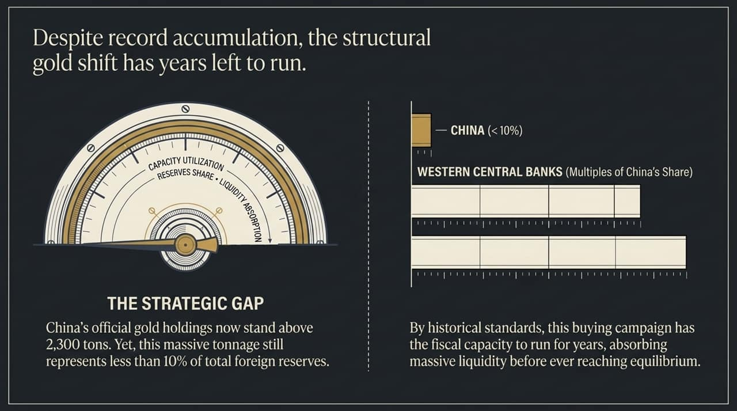
Notes:
[Capacity & Runway]: Despite China's record-breaking gold buying streak—pushing official holdings above 2,300 metric tons—gold still represents less than 10% of China's total foreign exchange reserves.
[Comparison with Western Reserves]: By contrast, major Western central banks like the US, Germany, and France hold upwards of 60% to 70% of their reserves in gold.
[Strategic Implication]: This proves that China's buying campaign is not near completion. They possess massive fiscal balance-sheet room to continue absorbing physical gold for years to come, further insulating their reserves against Western dollar sanctions.

Slide 9
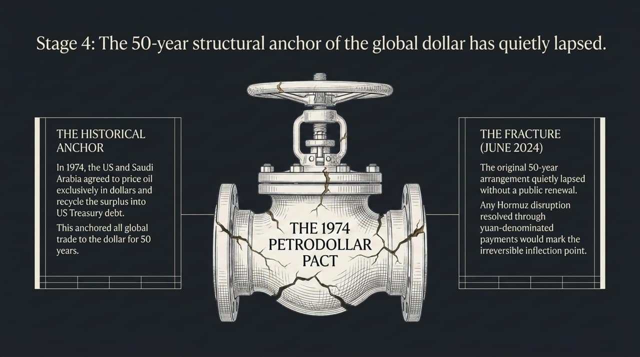
Notes:
[The 1974 Petrodollar Agreement]: Stage 4 targets the single anchor that has protected dollar demand for half a century: crude oil. In 1974, Washington reached an agreement with Saudi Arabia to price all crude oil sales exclusively in USD, recycling those proceeds into US Treasuries in exchange for military backing.
[The 2024 Fracture]: In June 2024, that 50-year structural agreement quietly expired without a public extension or fanfare. Shortly thereafter, Saudi officials publicly voiced an openness to accepting non-dollar currencies, including the Yuan, for energy contracts.
[Geopolitical Pressures]: Any major regional escalation—such as supply bottlenecks around the Strait of Hormuz cleared via non-dollar arrangements—serves as the catalyst for an irreversible shift in global energy settlement.

Slide 10
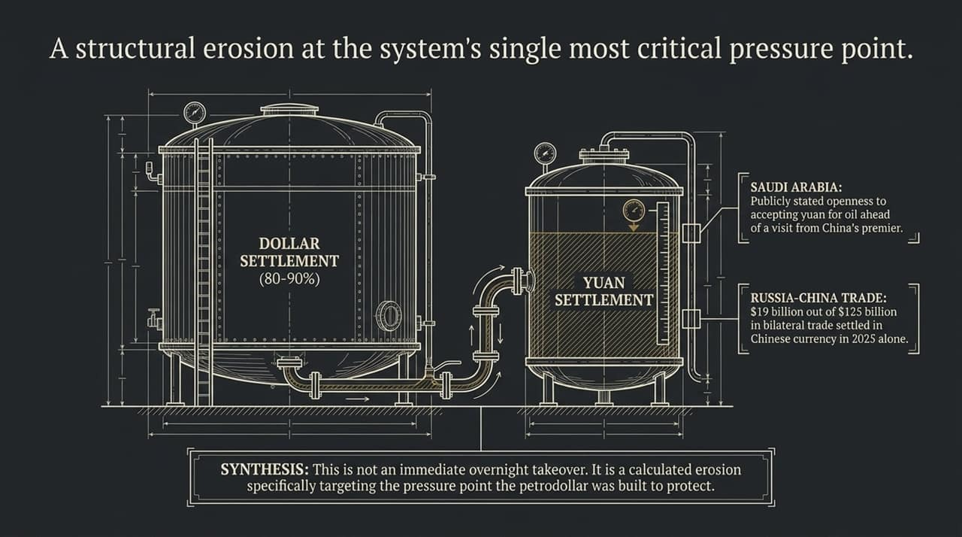
Notes:
[Erosion, Not Overnight Takeover]: We must be clear: the U.S. Dollar still settles between 80% and 90% of global oil markets. This is not an overnight structural collapse, but rather a calculated erosion at the specific pressure point the original petrodollar was designed to protect.
[Concrete Bilateral Numbers]: Look at the Russia-China trade channel: out of $125 billion in total trade volume, over $19 billion was settled directly in Chinese Yuan in 2025 alone. Similar bilateral clearing agreements are expanding across the Middle East, Africa, and South America.

Slide 11
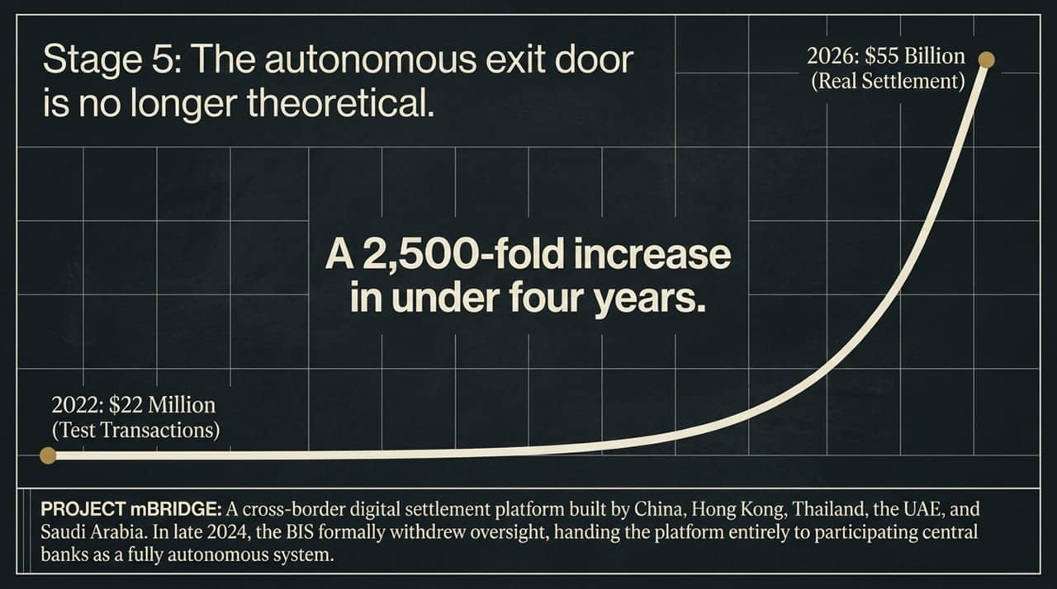
Notes:
[Project mBridge Overview]: Stage 5 delivers the autonomous exit door: Project mBridge. Developed jointly by central banks across China, Hong Kong, Thailand, the UAE, and Saudi Arabia, mBridge enables direct multi-CBDC cross-border transactions.
[Exponential Volume Growth]: In 2022, mBridge processed just $22 million in test transactions. By early 2026, real settlement volume exceeded $55 billion—a 2,500-fold expansion in under four years.
[BIS Exit & Autonomy]: Crucially, in late 2024, the Bank for International Settlements (BIS) formally stepped away from the project. They handed full operational ownership to the participating member central banks, turning mBridge into a completely autonomous clearing mechanism beyond Western sanction controls.

Slide 12
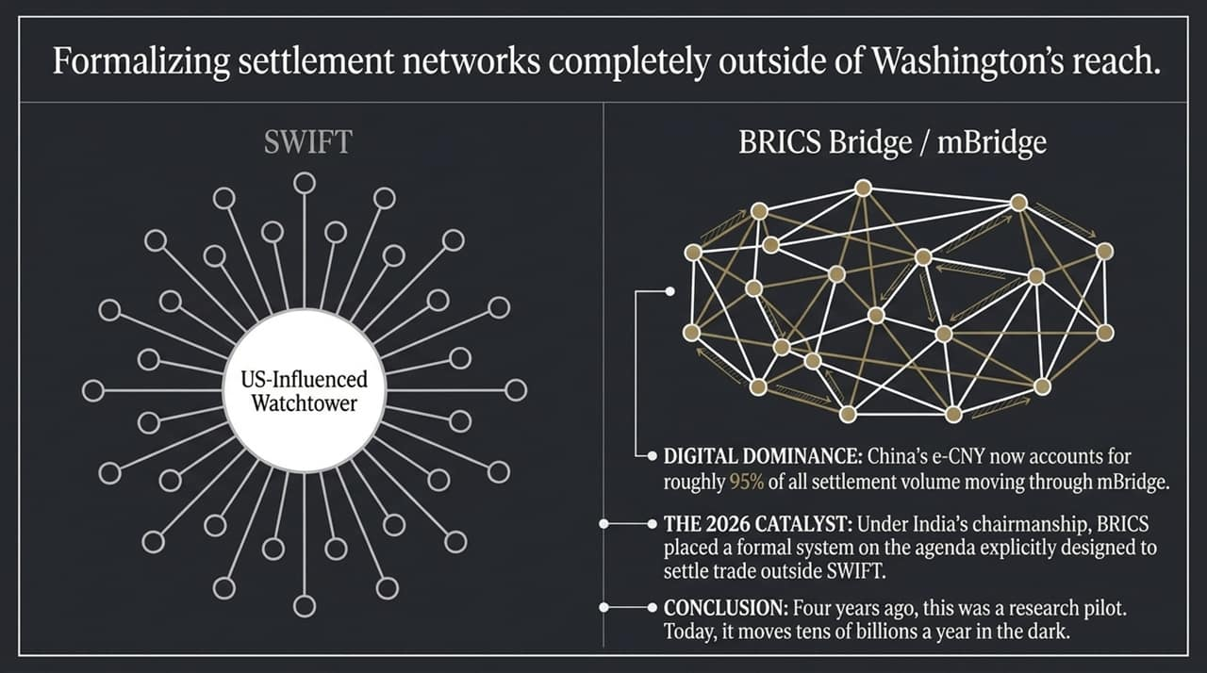
Notes:
[Hub-and-Spoke vs. Mesh Network]: This comparison highlights the architectural shift: SWIFT operates as a centralized hub-and-spoke system routed through Western correspondent banks and subject to US monitoring. mBridge operates as a decentralized mesh network.
[Digital Yuan Dominance]: China's e-CNY now accounts for roughly 95% of all transaction volume moving across mBridge.
[2026 BRICS Agenda]: In 2026, under India's chairmanship of the BRICS block, member states formally prioritized the 'BRICS Bridge' initiative—an explicit effort to scale non-SWIFT trade settlement across global emerging markets.

Slide 13
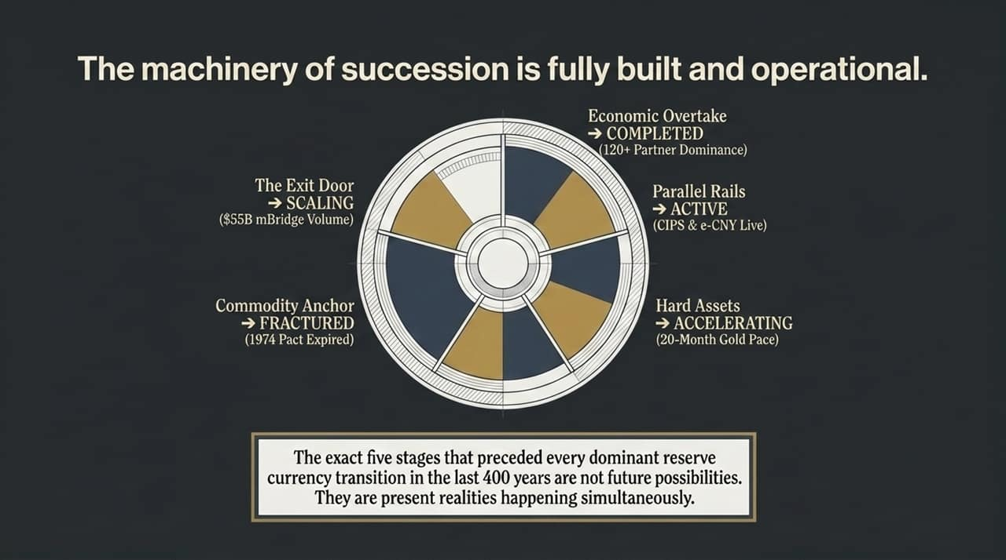
Notes:
[Operational Status Check]: Bringing all 5 stages together into a single diagnostic framework, we see that none of this remains in the theoretical phase:
Stage 1 (Economic Overtake): COMPLETED (120+ dominant trade partner relationships).
Stage 2 (Parallel Rails): ACTIVE (CIPS and e-CNY processing trillions).
Stage 3 (Hard Assets): ACCELERATING (Unbroken 20-month central bank gold buying).
Stage 4 (Commodity Anchor): FRACTURED (1974 Petrodollar agreement lapsed).
Stage 5 (The Exit Door): SCALING ($55B+ moving through mBridge).
[Key Takeaway]: Every historical precursor to a reserve currency shift is occurring simultaneously in the present day.

Slide 14
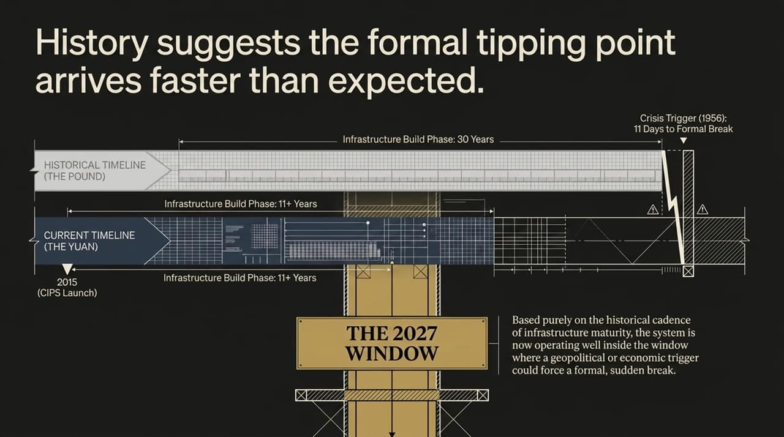
Notes:
[Timeline Analysis]: If we benchmark the Yuan's timeline against historical currency shifts, the current build phase began in earnest in 2015 with the launch of CIPS. That represents 11+ years of continuous infrastructure construction.
[The 2027 Window]: Historical models show that once parallel infrastructure matures, the system enters a high-vulnerability window where a single geopolitical or economic crisis can force a formal handoff.
[Strategic Window]: This historical cadence places the macro environment squarely inside the 2026–2027 window for a sudden, formal inflection point.

Slide 15

Notes:
[Refuting the Incumbent Argument]: Defenders of the status quo argue that the dollar is too deeply embedded in global plumbing to ever be replaced. History reminds us that the Dutch said the exact same thing about the Guilder, and the British said it about the Pound right up until 1956.
[The Final takeaway]: Economic history does not issue public warnings prior to a currency break; it only builds parallel infrastructure years in advance. The data does not care about narrative or permanence—it tracks what is being built, what is being bought, and what is being settled in the dark.

Slide 16
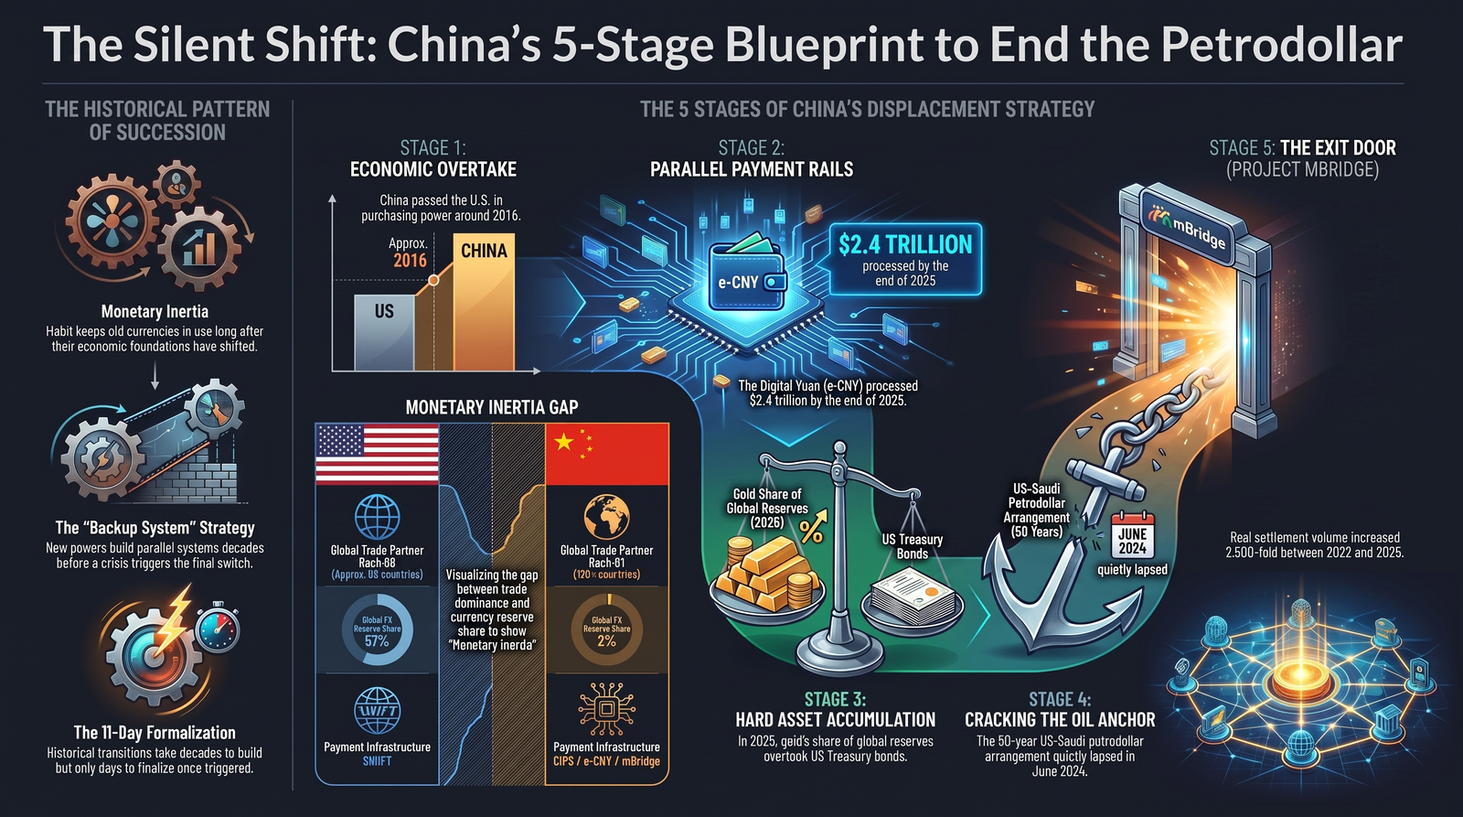
Notes:
[Synthesis for Decision-Makers]: To close our analysis, this comprehensive dashboard illustrates the complete structural shift happening across global monetary networks:
[Core Pillar Highlights]:
Trade vs. Reserve Dissonance: Real economy trade dominance (<120 countries) has detached from fiat reserve holdings.
Alternative Infrastructure: CIPS, e-CNY, and mBridge provide a fully redundant, un-sanctionable financial architecture.
Hard Asset Re-anchoring: Gold reserves replacing US debt paper on sovereign balance sheets.
[Closing Call to Action]: The infrastructure replacing the 50-year petrodollar framework is already fully built, active, and handling tens of billions of dollars outside Western oversight. Investors and decision-makers must watch the underlying plumbing rather than the headlines.

